Slide 1




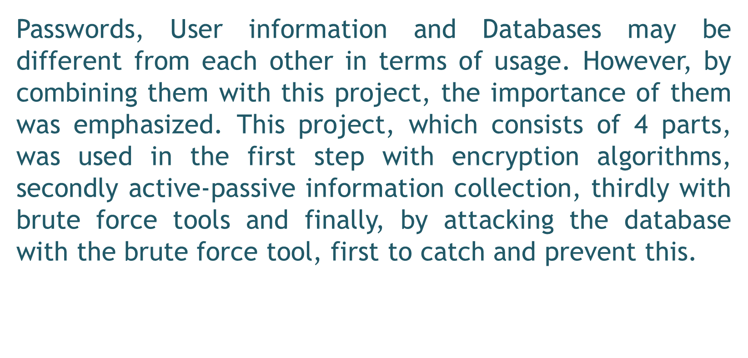
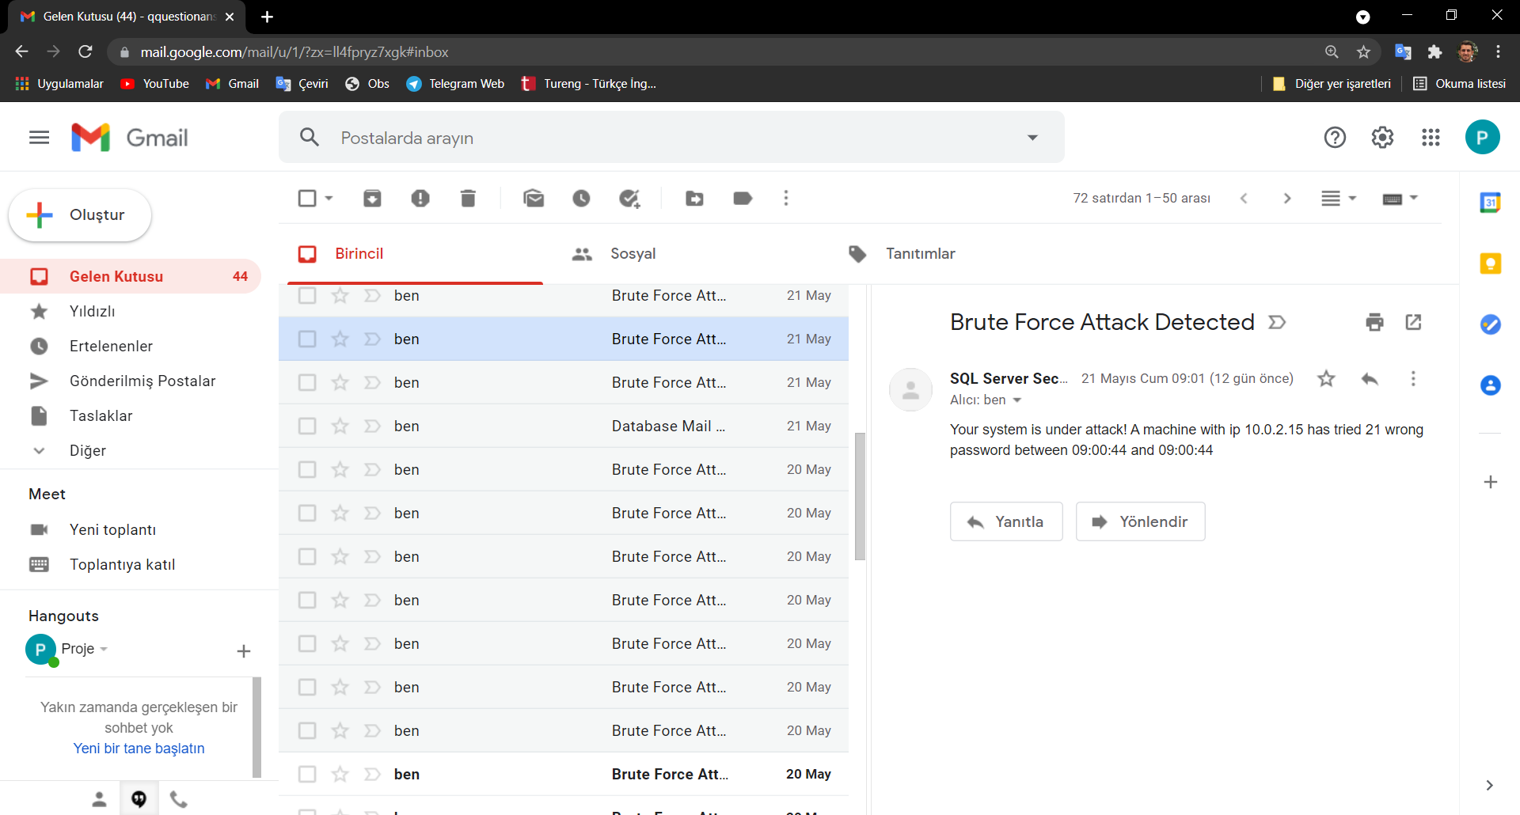
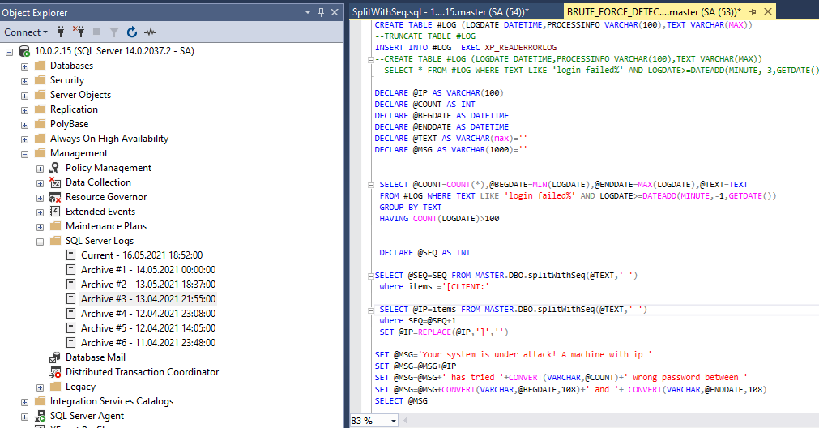
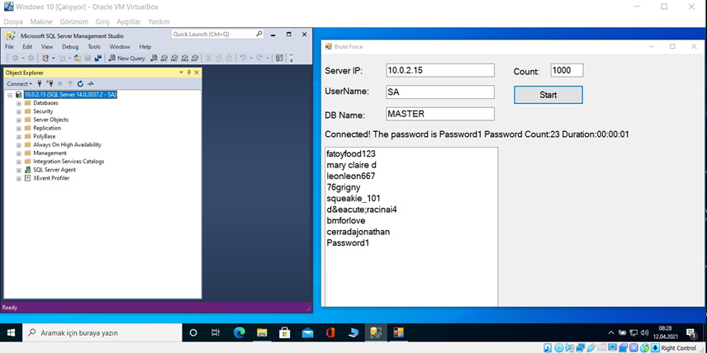
INTRODUCTION
METHODS
  Asymmetric Encryption
  Symmetric Encryption
  Active Information Gathering
  Passive Information Gathering
  Brute Force Tools
  Making Simple Brute Force Tool
  Capture the attack by the attacker
  Automate the capture system
  Reporting the attack to the authority
  Blocking the Attack
OBJECTIVES
The general purpose of this thesis is to prevent an attack on the database. This is how I plan to do it;
First, I will show the user how to store their passwords with encryption algorithms.
Secondly, I will show you how easily the user's information can be obtained with active and passive information collection by showing many tools.
Thirdly, I will explain the brute force tools, the purpose of which is to show that an attacker, who easily obtains the information of a user, can obtain our encryption with a basic tool. As a way of protection, we can create passwords with encryption algorithms or prepare for this brute force attack by knowing how important their information is by not sharing them everywhere. I want them to have this thought.
Finally, creating a security mechanism for databases used by most corporate or individual users. After writing a brute force tool, I will attack the database with this tool. Here, I will determine the IP address made from the logs and send the attack information to the product owner by mail. And finally, I aim to prevent the attack by blocking this IP address by blacklisting it.
RESULTS
  It was shown to the reader with Encryption Algorithm how passwords are kept.
  Active and passive information collection was shown how an attacker collects information for his/her victim.
  After the results obtained from these, brute force tools were explained so that the user could see an attacker at each stage.
  Finally, an attack was carried out on a database and this attack was caught and the authority was informed, then this event was automated and turned into a working machine in 3 minutes. Thus, the attack was caught and prevented.

